Slide 1
Introduction to Weka

Slide 2
Waikato Environment for Knowledge Analysis
Data mining tool / Machine learning algorithms.
Open source project

Slide 3
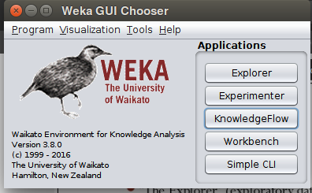
Interface
1 .Exploratory data analysis
2. Expermenter environment
3. Knowledge Flow
4. Simple CLI

Slide 4
Dataset format in weka
Data set are in ARFF format
Format:
@relaion name
@attribute attribute_name{ values }
Values can be of nominal,Numeric,String,Data
After the atrribute declarations the actual data is intriduced by a tag.
@data

Slide 5
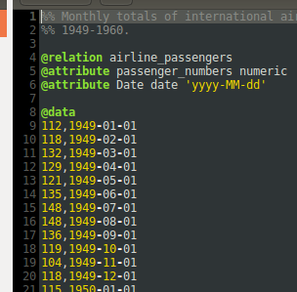
There are some sample data in weka/Data/ direcotory
like this one airline.affr

Slide 6
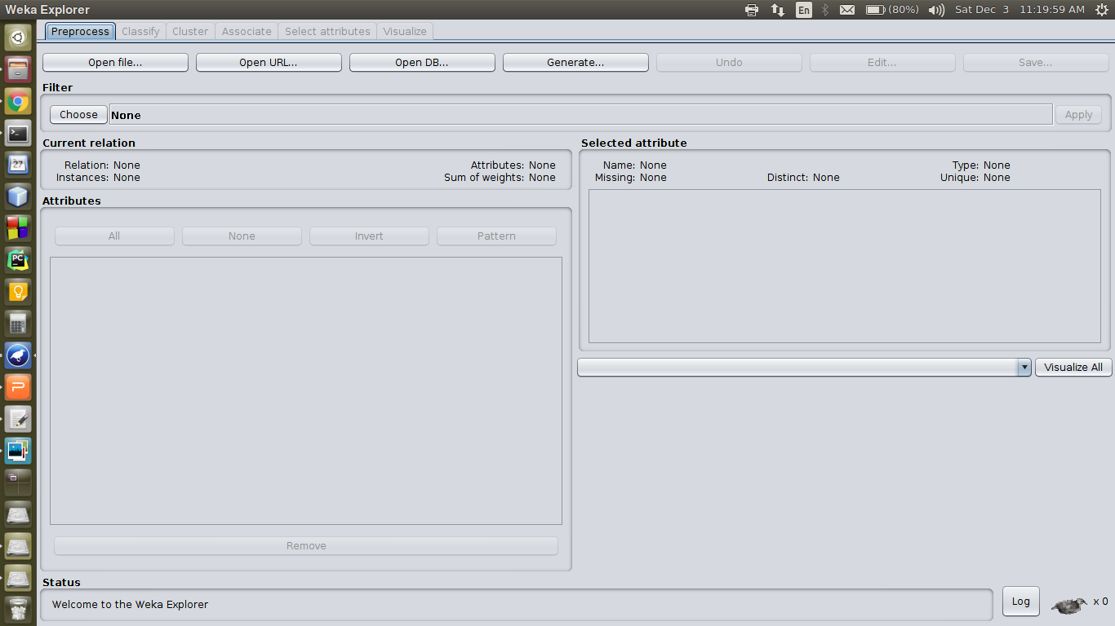
Weka Explorer

